Slide 1
Finding Islands, Gaps, and Clusters in Complex Data
Ed Pollack
Database Administrator
CommerceHub

Slide 2
Agenda
Finding Significant Patterns in Complex Data
Quick Review: Structured/Inorganic Groupings
Quick Review: Gaps & Islands in Simple Data
Finding Data Clusters
Answering Crazy Questions
TSQL Madness
More Demos
Performance
Conclusion

Slide 3
Structured/Inorganic Groupings
We can partition data into segments based on static groupings.
Often dates or date parts, but can be other metrics.
Easy to visualize & understand.
Does not provide recursive/self-referencing feedback.
Boundaries can divide data into ill-conceived groupings.

Slide 4
Structured Groupings
Demo

Slide 5
Basic Gaps/Islands Analysis
A self-joining query (of some sort) can locate missing data and build analysis based on it.
Useful for analyzing consistent sequences of data.
Can determine streaks, both positive or negative.
Many ways to perform analysis on numeric data.
Carefully consider data quality prior to analysis!!!

Slide 6
Basic Gaps/Islands Analysis
Demo

Slide 7
Finding Data Clusters
Data can be organically grouped based on self-referential criteria.
Allows for related events to be identified.
Introduces internal proximity into analytics.
Data groups itself into clusters, regardless of external metrics.
Must determine grouping rules prior to analysis.

Slide 8
Finding Data Clusters
Demo

Slide 9
Answering Crazy Questions
Filters can control what data we include.
Existence checks control cluster parameters.
Join predicates determine what to group together.
Examples of metrics:
Streaks, droughts, performance, unusual patterns, etc…
Dynamic SQL: Loop through dimensions to gather semi-automated insight.

Slide 10
Answering Crazy Questions
Lots and Lots of Demos

Slide 11
Performance
Generally, these analytics rely on index/table scans.
Not intended for OLTP. Run on data that is:
Replicated, AG, ETL, OLAP, restored, etc
Helpful tools:
Covering indexes.
Columnstore indexes.
In-Memory OLTP.
Automated analytics.
Incremental Data Loads

Slide 12
Gotchas
Fully understand data quality:
NULLs
Missing data
Unexpected inputs/data values
Duplicate data
The borders of a cluster within a multi-partitioned data set may require special treatment.
QA: thoroughly test all use cases!

Slide 13
Conclusion
Data can be organically grouped, regardless of complexity.
Results can be used to determine many useful metrics:
Winning/losing streaks.
Data clusters.
Related events.
Patterns or abnormalities within data
Be creative and find innovative solutions to seemingly impossible problems.

Slide 14
Questions???

Slide 15
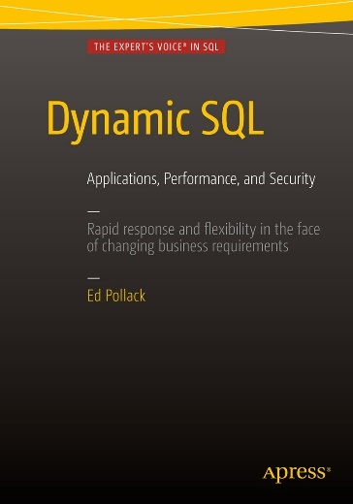



Contact Info & Links for Ed Pollack
ed7@alum.rpi.edu
@EdwardPollack
SQL Shack
SQL Server Central
Dynamic SQL: Applications, Performance, and Security
SQL Saturday Albany (2016)
Thank you!!!

